Slide 1






VLSI Physical Design Implementation of a Post-Quantum Cryptographic Accelerator SoC
Project Guide: Dr. Velmathi G.
Team Members:
Subham Prasad Gupta (23BVD1039)
Jairus Solomon Samraj (23BVD1040)
Vinayak Shreenivas Salunke (23BVD1062)

Slide 2

Implementation Work Distribution
RTL to Synthesis Work Distribution
Subham | Jairus | Vinayak
Modular Arithmetic | Polynomial Processing | Keccak / SHAKE
NTT / INTT | Matrix-Vector Multiplication | Sampling
Pointwise Polynomial Multiplication | Compression / Decompression | Matrix Generation
Transform Datapath | ML-KEM Control | Encryption
Arithmetic Optimization | KeyGen / Decapsulation | Cryptographic Datapath
Arithmetic Pipelining | SoC Integration | Encryption Pipelining
Synthesis & Timing Analysis | Baseline Synthesis | Final Pipeline Optimization

Slide 3


Arithmetic & Transform Engine (Subham)
Pipeline Type 1 — Initial Pipelined Architecture
Run | Frequency | Purpose
Run 1 | 50MHz / 180nm | Initial timing evaluation
Run 2 | 100 MHz / 90nm | Timing eval at target freq
Modular Arithmetic
  mod_add.v
  mod_sub.v
  mod_mult.v
  mod_mult_top.v
  mod_reduce_3329.v
NTT
  ntt.v
  ntt_butterfly.v
  ntt_memory.v
  ntt_zetas_rom.v
  ntt_flat.v
INTT
  intt.v
  intt_butterfly.v
  intt_scheduler.v
  intt_zetas_rom.v
  intt_flat.v
Polynomial Multiplication
  poly_mul_pointwise.v
Pipeline Type 2 — Final Architecture
Run | Frequency | Purpose
Run 3 | 250MHz | High-frequency stress test
Responsibility
Implementation of ML-KEM modular arithmetic and NTT/INTT transform datapaths, including polynomial multiplication in the NTT domain. Evaluated the initial pipelined architecture at 50/100 MHz and performed the 250-MHz stress test on the final pipelined architecture.

Slide 4

Arithmetic Datapath Pipelining: poly_mul_pointwise.v
Original critical path:
mod_mult
↓
mod_mult
↓
mod_add
Code-level changes
Declarations
  Added stage1_valid
  Added stage2_valid
  Added Stage-1 → Stage-2 registers:
    p_a0b0_r
    p_a1b1_r
    p_a0b1_r
    p_a1b0_r
    gamma_r
    idx_i_r
Datapath
  Separated the second mod_mult from the first stage.
  p_gamma now operates on registered p_a1b1_r.
  Final mod_add operates after the pipeline boundary.
Control
  Added valid propagation:
    stage1_valid
    stage2_valid
  Modified COMPUTE state to:
    Capture Stage-1 results.
    Propagate valid.
    Perform Stage-2 writeback.
Reset
  Added reset initialization for all new pipeline registers and valid signals.
Latency
  Total operation increased to approximately 129 cycles, only one additional cycle relative to the previous implementation.
Pipeline modification:
STAGE 1
4 × mod_mult
↓
PIPELINE REGISTERS
↓
STAGE 2
mod_mult + mod_add
Notes:
Post-quantum cryptography refers to cryptographic algorithms designed to resist attacks from quantum computers while still running on conventional computing systems. This is important because the cryptography does not itself require a quantum computer. NIST has already standardized ML-KEM for key encapsulation and ML-DSA and SLH-DSA for digital signatures. For our hardware accelerator, we are particularly interested in lattice-based cryptographic computation, especially the computational kernels associated with ML-KEM.

Slide 5
Arithmetic Datapath Pipelining: mod_reduce_3329.v
Code-level changes to mention
Depending on the exact pipelined revision you used, the changes should include:
  Added clock/reset interface
  Added registers for the reciprocal multiplication result
  Registered the quotient estimate
  Registered intermediate quotient/product values
  Separated the Barrett reduction into multiple sequential stages
  Added valid/control propagation if the surrounding datapath required it
  Reset all newly introduced pipeline registers
  Updated downstream timing/latency expectations
Purpose
Break the long Barrett-reduction combinational path into shorter arithmetic stages while preserving modulo-3329 functionality.
Original critical path:
value × MU
↓
quotient estimation
↓
quotient × Q
↓
remainder
↓
conditional reduction
Pipelined:
STAGE 1 STAGE 2
value × MU → REGISTER → quotient estimation → REGISTER → quotient × Q → remainder → conditional reduction
Notes:
Post-quantum cryptography refers to cryptographic algorithms designed to resist attacks from quantum computers while still running on conventional computing systems. This is important because the cryptography does not itself require a quantum computer. NIST has already standardized ML-KEM for key encapsulation and ML-DSA and SLH-DSA for digital signatures. For our hardware accelerator, we are particularly interested in lattice-based cryptographic computation, especially the computational kernels associated with ML-KEM.

Slide 6
CODE-LEVEL PIPELINE SUMMARY
poly_mul_pointwise.v
Added
p_a0b0_r
p_a1b1_r
p_a0b1_r
p_a1b0_r
gamma_r
idx_i_r
│
▼
stage1_valid → stage2_valid
Timing objective:
Break the multiplier cascade and reduce the arithmetic critical path.
The source comments in your current RTL describe the intended improvement as approximately:
~14 ns → ~5 ns
which is useful as an RTL-level timing target/analysis point, but distinguish it from the final Genus WNS results.
Notes:
Post-quantum cryptography refers to cryptographic algorithms designed to resist attacks from quantum computers while still running on conventional computing systems. This is important because the cryptography does not itself require a quantum computer. NIST has already standardized ML-KEM for key encapsulation and ML-DSA and SLH-DSA for digital signatures. For our hardware accelerator, we are particularly interested in lattice-based cryptographic computation, especially the computational kernels associated with ML-KEM.

Slide 7
Polynomial/Vector Processing & System Control (Jairus)
Polynomial Operations
  poly_add.v
  poly_sub.v
Matrix / Vector Datapath
  matrix_vec_mul.v
Compression / Representation
  poly_compress.v
  poly_decompress.v
SoC Integration
  mlkem_peripheral.v
  mlkem_picosoc_top.v
ML-KEM Control
  mlkem_top.v
  mlkem_keygen.v
  mlkem_dec.v
Pipeline Type 1: No-Pipeline ML-KEM
Run | Frequency / lib | Purpose
Baseline 1 | 100 MHz / 90nm | Initial synthesis
Baseline 2 | 100 MHz / 90nm | Timing characterization
Additional work
Initial synthesis debugging, Datapath error correction, Baseline timing analysis, Critical-path identification, SDC/constraint debugging.
System Integration
  PicoRV32 ↔ PicoSoC ↔ ML-KEM peripheral
  Memory-mapped control/status interface
  ML-KEM operation sequencing
Responsibility
Polynomial/vector processing, ML-KEM operation control and integration of the accelerator with the PicoSoC/PicoRV32 system. Decouple pointwise multiplication from the following parallel polynomial-addition paths.

Slide 8
MATRIX-VECTOR PIPELINING: matrix_vec_mul.v
Original critical path:
poly_mul_pointwise
↓
256-coefficient poly_add
↓
256-coefficient poly_add
Code-level changes
New registers:
prod_A00_s0_r
prod_A01_s1_r
prod_A10_s0_r
prod_A11_s1_r
New control signal:
pm_start2
FSM modified
Original row processing was reorganized into:
IDLE → ROW0 → LATCH_ROW0 → ROW1 → LATCH_ROW1 → FINISH
Sequential changes:
  Capture row-0 multiplication outputs into registers.
  Start row-1 processing in a separate state.
  Capture row-1 outputs.
  Delay done until both registered results are available.
Reset changes:
  Initialize all four holding registers.
  Initialize pm_start2.
Objective:
Decouple pointwise multiplication from the following parallel polynomial-addition paths.
Pipeline modification:
poly_mul_pointwise
↓
REGISTER
↓
poly_add
↓
poly_add
Notes:
Post-quantum cryptography refers to cryptographic algorithms designed to resist attacks from quantum computers while still running on conventional computing systems. This is important because the cryptography does not itself require a quantum computer. NIST has already standardized ML-KEM for key encapsulation and ML-DSA and SLH-DSA for digital signatures. For our hardware accelerator, we are particularly interested in lattice-based cryptographic computation, especially the computational kernels associated with ML-KEM.

Slide 9
Cryptographic Datapath (Vinayak)
Pipeline Type 2 — Final Architecture
Run | Frequency / lib | Purpose
Run 1 | 100MHz / 45nm | Test run at lower process parameter
Run 2 | 100 MHz / 90nm | Timing evaluation at target frequency
Matrix Generation
  mlkem_matrix_gen.v
ML-KEM Encryption
  mlkem_enc.v
Encoding / Decoding
  poly_encode.v
  poly_decode.v
Keccak / SHAKE
  keccak_f1600.v
  shake128_xof.v
Sampling
  cbd_sampler.v
  rejection_sampler.v
  poly_uniform.v
Contribution
Implementation of cryptographic primitives, sampling, matrix generation and the ML-KEM encryption datapath. Final pipeline architecture, Timing-driven RTL restructuring, Final mlkem_enc pipeline implementation, Synthesis/timing evaluation, Achieved 0-slack operation at 100 MHz

Slide 10
ENCRYPTION PIPELINING: mlkem_enc.v
Original critical path:
NTT
↓
Matrix-Vector Multiplication
↓
INTT
↓
Polynomial Addition
↓
Compression
The INTT completion path was followed directly by:
  poly_add(e2)
  poly_add(message)
  768 parallel poly_compress units
This created a long combinational path.
Pipeline modification
INTT
↓
u0/u1/v REGISTER
↓
RUN_COMPRESS
↓
Compression
Code-level changes:
New holding registers
u0_spatial_r
u1_spatial_r
v_final_r
Compression inputs changed:
Previously: u0_spatial, u1_spatial, v_final
Compression now operates on:
u0_spatial_r, u1_spatial_r, v_final_r
New FSM state:
RUN_COMPRESS
IDLE
↓
RUN_NTT
↓
RUN_MVM
↓
RUN_INTT
↓
RUN_COMPRESS
↓
FINISH
Objective
Isolate the compression logic from the INTT/message-addition timing path.
The RTL comments identify an approximately 5-ns critical-path reduction from this restructuring.
Notes:
Post-quantum cryptography refers to cryptographic algorithms designed to resist attacks from quantum computers while still running on conventional computing systems. This is important because the cryptography does not itself require a quantum computer. NIST has already standardized ML-KEM for key encapsulation and ML-DSA and SLH-DSA for digital signatures. For our hardware accelerator, we are particularly interested in lattice-based cryptographic computation, especially the computational kernels associated with ML-KEM.

Slide 11
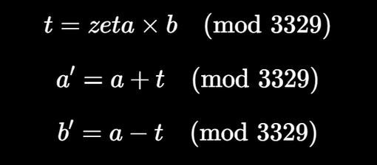
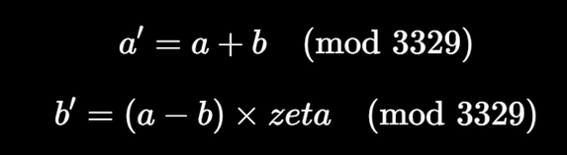
Arithmetic + NTT / INTT TB
Tests the NTT butterfly. It applies random/boundary values of a, b, and zeta.
It independently calculates:
It then compares these expected values against ntt_butterfly's a_out and b_out.
Tests the INTT butterflySimilarly verifies the inverse butterfly using:
This ensures the individual INTT butterfly operation follows the required modular arithmetic.
TB Uses 20,000 test vectors
It deliberately includes boundary cases such as 0, Q-1, and the previousl problematic:
a=100, b=50, zeta=2.

Slide 12
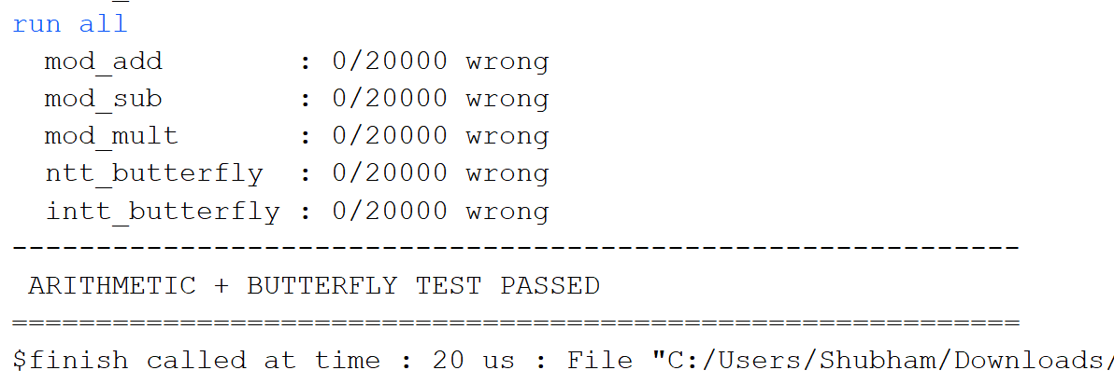
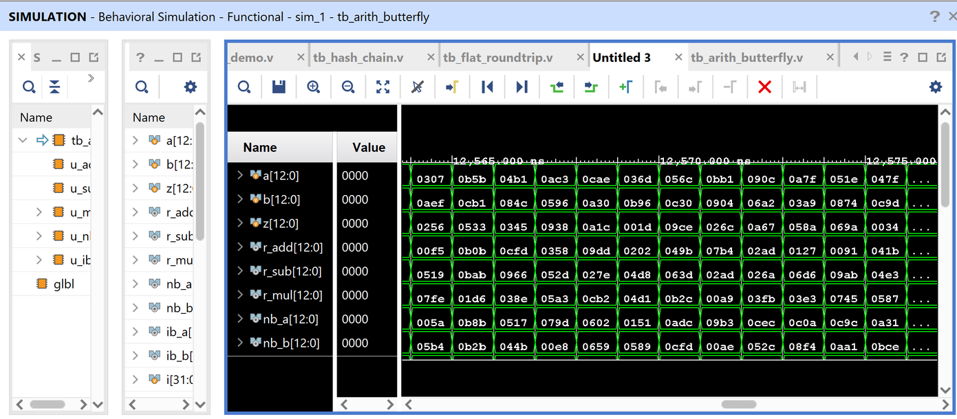
Arithmetic + NTT / INTT TB
Level 1: Arithmetic primitives
↓
mod_add/sub/mult
↓
Level 2: Butterfly primitives
↓
NTT / INTT butterfly
↓
Level 3: Transform engines
↓
Complete NTT / INTT
↓
Level 4: Adapters
↓
ntt_flat / intt_flat
↓
Level 5: ML-KEM accelerator
↓
Level 6: PicoRV32 + ML-KEM SoC

Slide 13
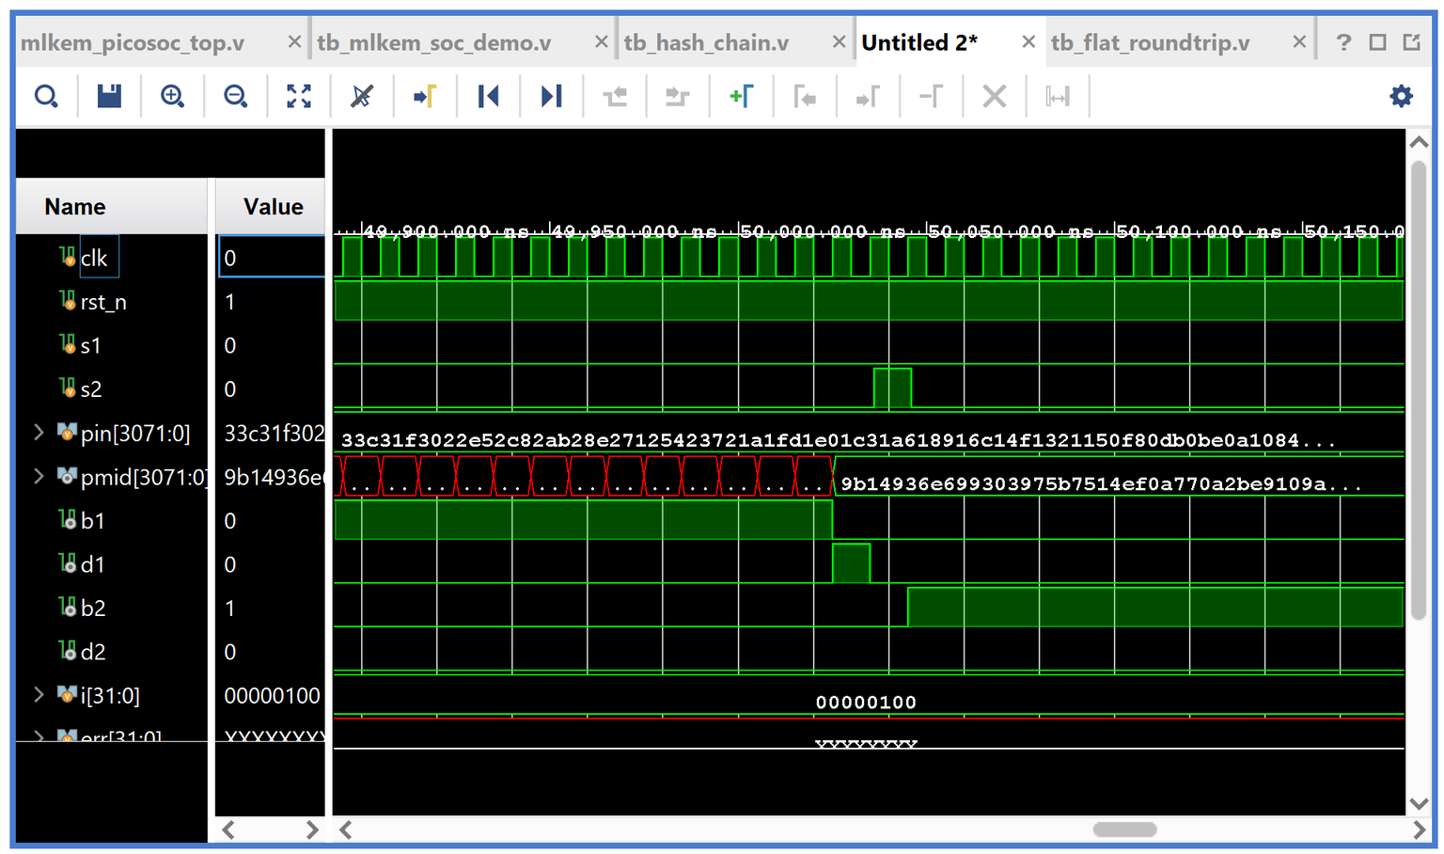
Round Trip
TB
Input:
256 known polynomial coefficients modulo 3329
Operation: Polynomial → NTT → INTT → Reconstructed Polynomial
Result: 0/256 coefficient mismatch
→ Round-trip PASSED

Slide 14
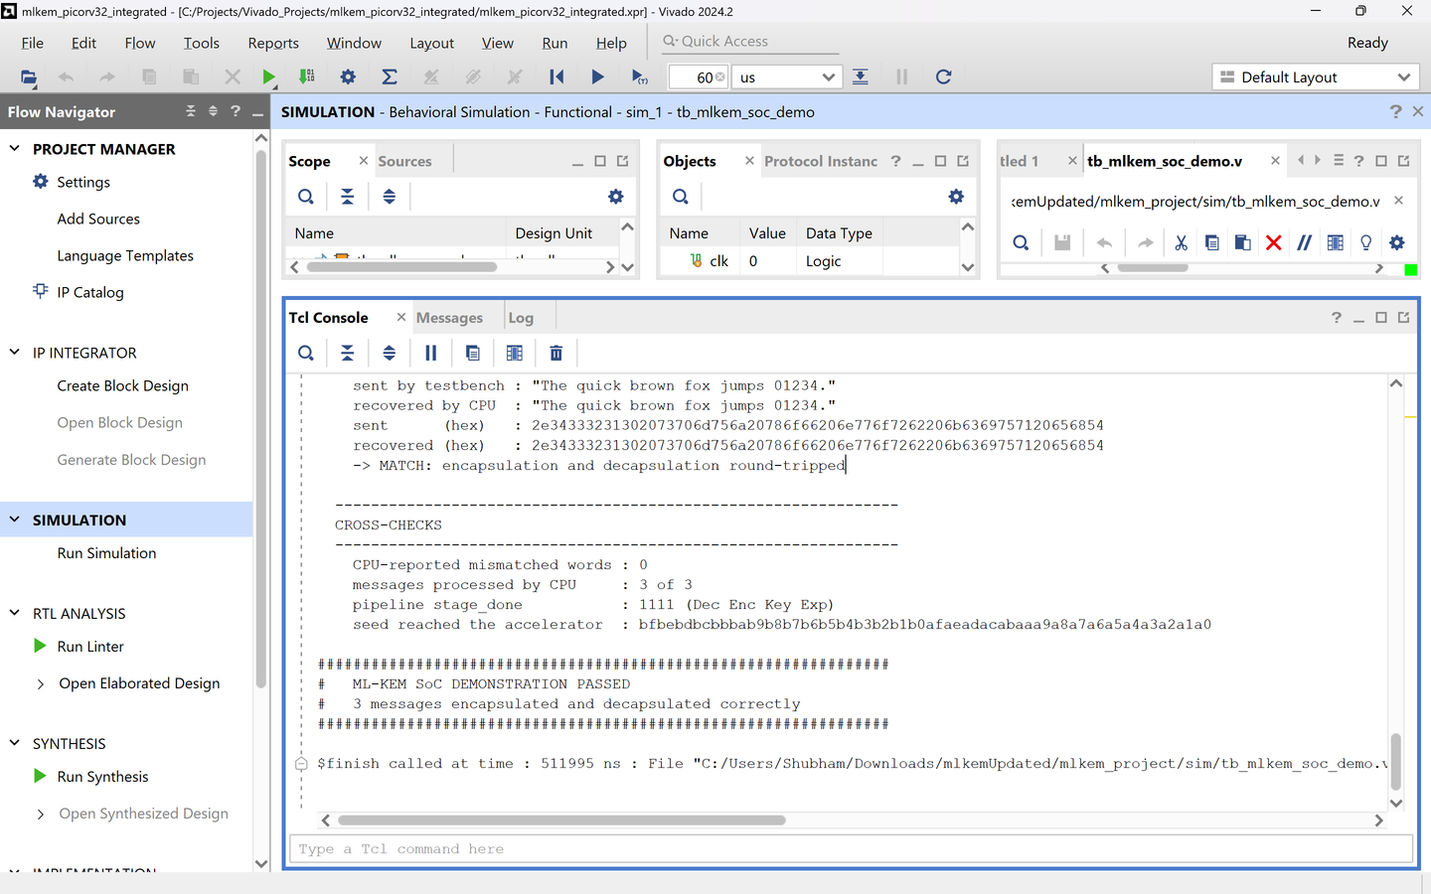
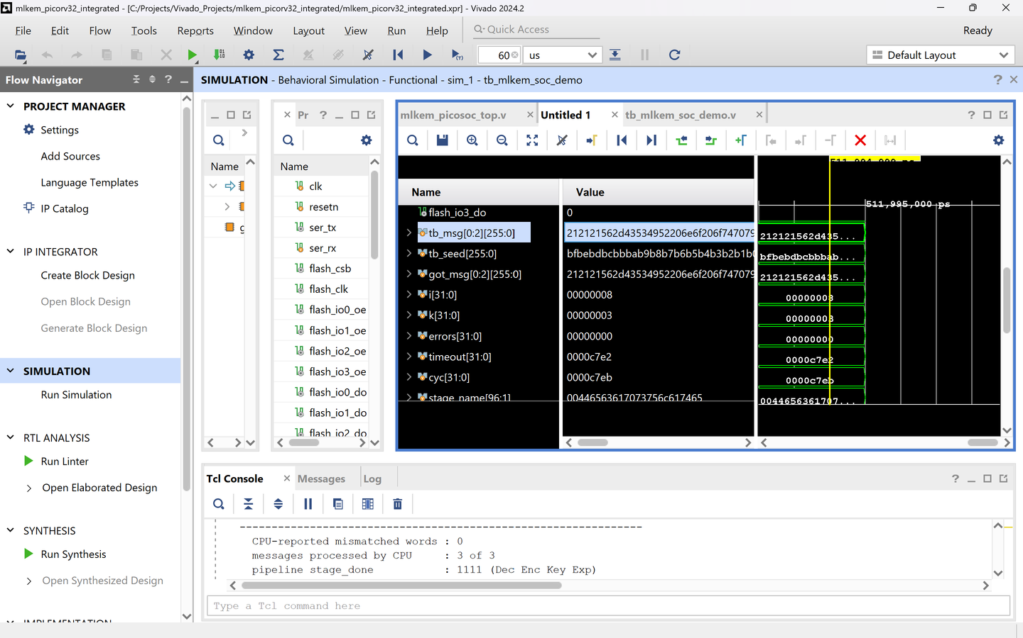
SOC Demo Testbench
Testbench → PicoSoC RAM → PicoRV32 → MMIO ML-KEM Accelerator → PicoRV32 → PicoSoC RAM → Testbench
---------------------------------------------------------------
CROSS-CHECKS
---------------------------------------------------------------
CPU-reported mismatched words : 0
messages processed by CPU : 3 of 3
pipeline stage_done : 1111 (Dec Enc Key Exp)
seed reached the accelerator : bfbebdbcbbbab9b8b7b6b5b4b3b2b1b0afaeadacabaaa9a8a7a6a5a4a3a2a1a0
################################################################
# ML-KEM SoC DEMONSTRATION PASSED
# 3 messages encapsulated and decapsulated correctly
################################################################

